Slide 1

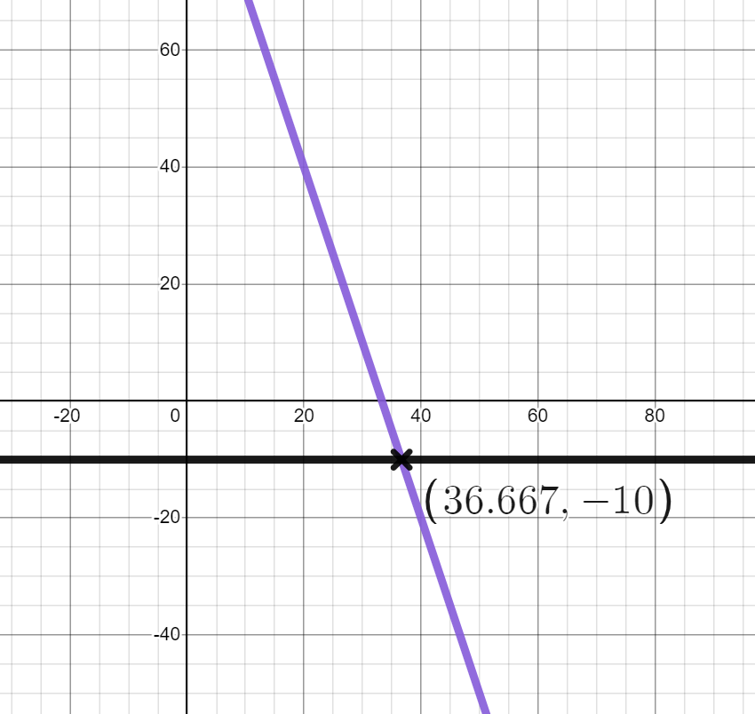

Graphing special number sequences using technology
Task A: Plotting sequences using Desmos
Lucas wants to know if −10 is in the sequence 100 − 3n
I have plotted the lines y = 100 − 3n and y = −10. They intersect so −10 is a term in the sequence 100 − 3n
a) What has Lucas done correctly?
He has plotted the correct lines and looked for the intersection point.
Lucas
b) Explain to Lucas what mistake he has made.
To be in the sequence, the x coordinate has to be an integer. This coordinate shows −10 is between the 36th and 37th term but is not in the sequence.
2) Use Desmos to match these sequences to their n^{th} term rules
a) Geometric sequence with first five terms: 2, 4, 8, 16, 32, …
4 × 3^{n}
b) Geometric sequence with first five terms: 8, 16, 32, 64, 128, …
3 × 2^{n}
c) Geometric sequence with first five terms: 6, 12, 24, 48, 96, …
2 × 3^{n}
d) Geometric sequence with first five terms: 6, 18, 54, 162, 486, …
2^{n}
e) Geometric sequence with first five terms: 12, 36, 108, 324, 972, …
2^{n + 2}

Slide 2
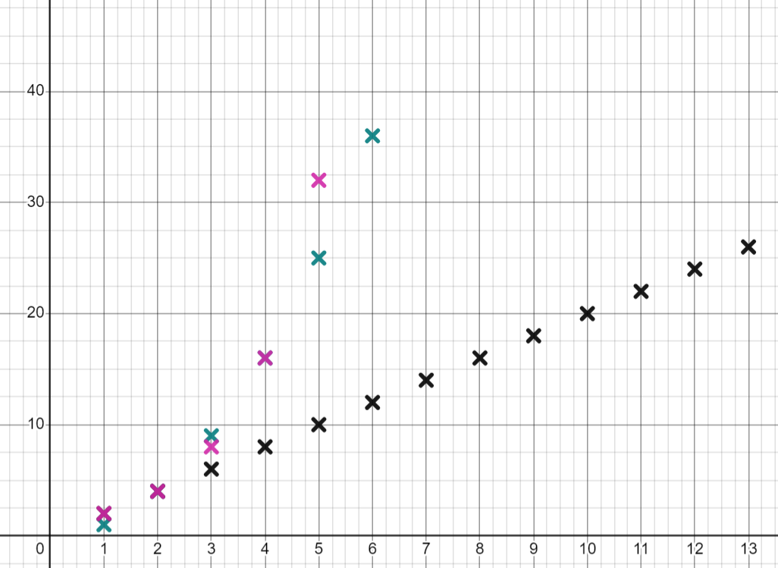
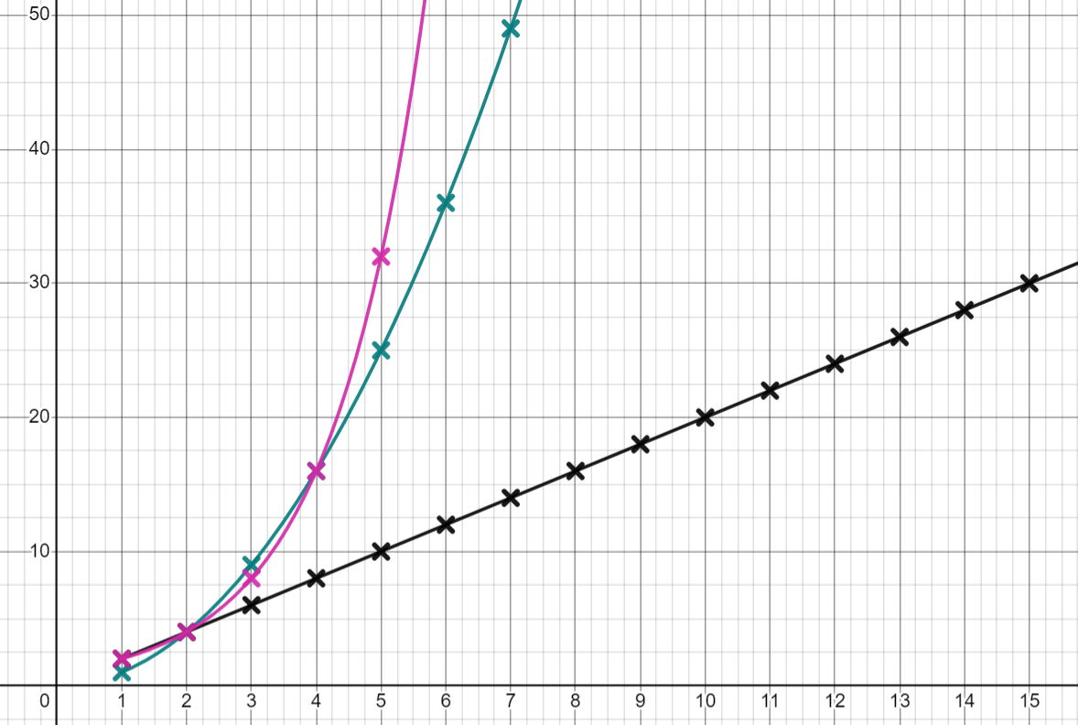
Graphing special number sequences using technology
3) Use graphing software to help with the following questions.
a) Is the number 30 in this sequence?
Term number | 1 | 2 | 3 | 4 | n
Term | −1.5 | 0.6 | 2.7 | 4.8 | 2.1n − 3.6
Yes the 16th term
b) Is the number 2044 in this sequence?
Term number | 1 | 2 | 3 | 4 | n
Term | 8 | 24 | 72 | 216 | 8 × 3^{n − 1}
No between the 6th and 7th term
c) Is the number 1280 in this sequence?
Term number | 1 | 2 | 3 | 4 | n
Term | 10 | 20 | 40 | 80 | 5 × 2^{n}
Yes the 8th term
d) Is the number 4004 in this sequence?
Term number | 1 | 2 | 3 | 4 | n
Term | 4 | 16 | 64 | 256 | 4^{n}
No between the 5th and 6th term
Task B: Exploring special number sequences
1a) Plot the first 20 points of the sequences 2n, n² and 2^{n}
Adding the curves in may help see key features of these sequences
b) Two of the sequences have the same first term, which two? 2n and 2^{n}
c) What is happening at the coordinate (2,4) what does this mean about the sequences? All three sequences have a second term of 4
d) Which sequence is increasing at the fastest rate? 2^{n}
e) Find four numbers which are in the sequence 2n and 2^{n}
all numbers in 2^{n} are also in 2n so 2, 4, 8, 16, 32, 64, 128,.....
f) What is the 15th term in the sequence 2^{n}? 32 768

Slide 3
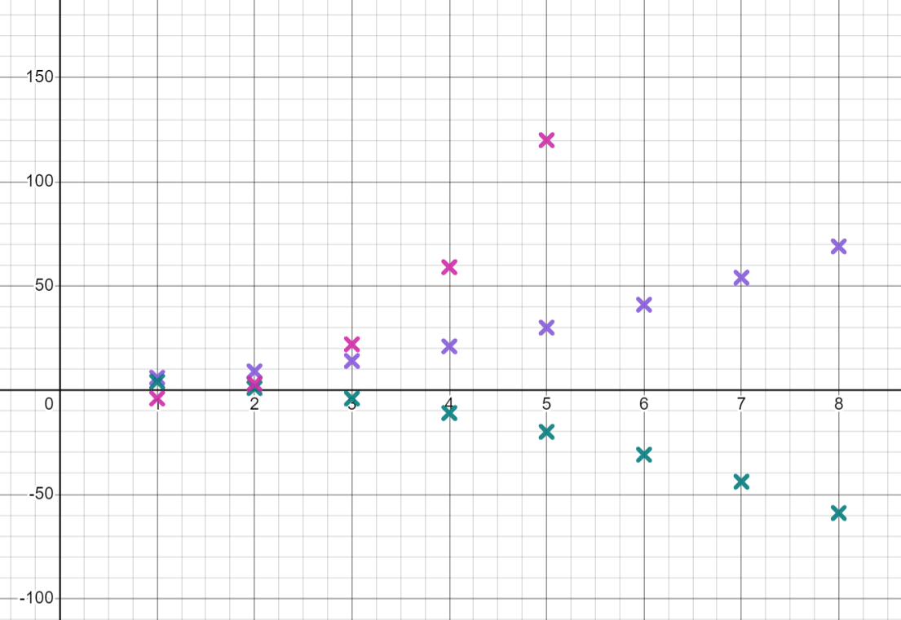
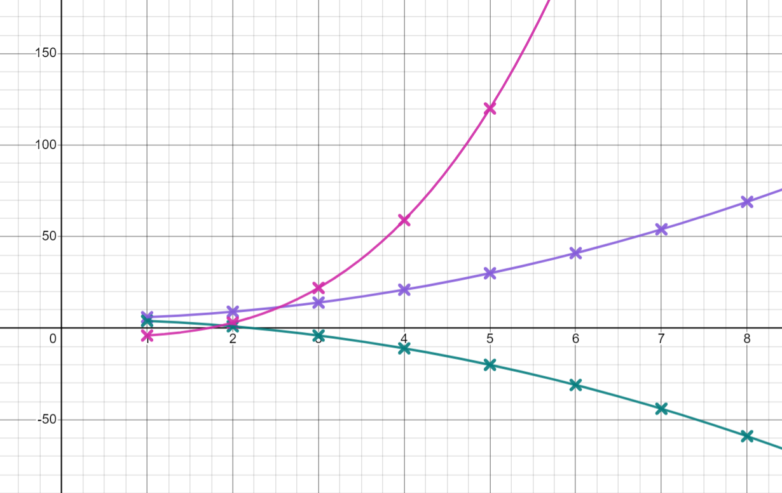
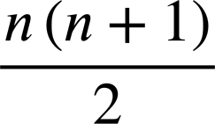
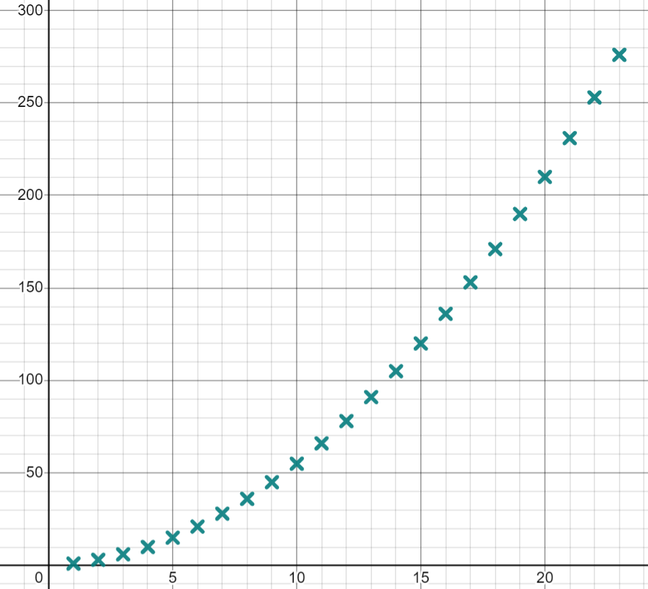
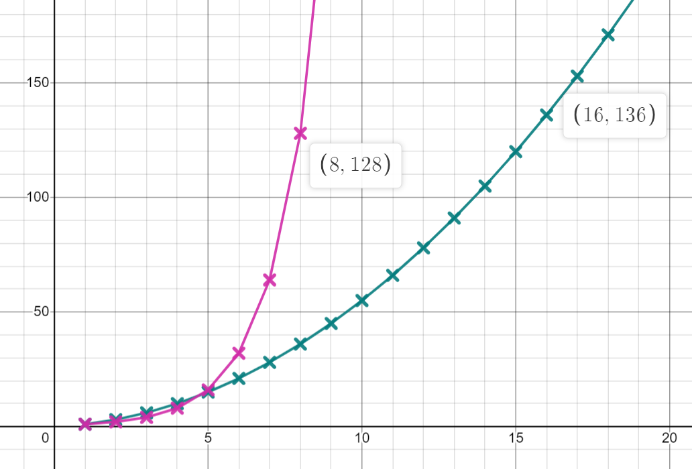
Graphing special number sequences using technology
2a) Plot the first 20 points of the sequences 5 − n², 5 + n² and n³− 5
Adding the curves in may help see key features of these sequences
b) Which sequence has the smallest 1st term? n³− 5
c) Which sequence has the smallest 2nd term? 5 − n²
d) Which sequence has the largest 3rd term? n³− 5
e) What do you notice about the sequences 5 + n² and 5 − n²?
You may have said: they are reflections of each other, the terms in 5 + n² are always larger than the terms in 5 − n²
3a) The sequence of all triangular numbers has the n^{th} term rule
plot the first 20 terms.
b) What is the 19th triangular number?
c) The geometric sequence which starts 1, 2, 4, 8,... has the n^{th} term rule 2^{n − 1}
at what term number does this sequence overtake the triangular numbers?
e) Which is larger the 8th term in the sequence 2^{n − 1} or the 16th triangular number.
190
Term 5
The 16th triangular number (136 > 128)

Slide 4
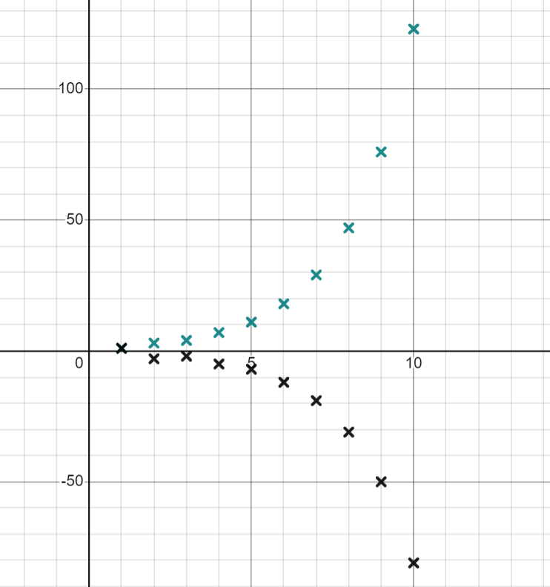
Graphing special number sequences using technology
4a) A sequence starts 1, 3, 4, … the next term is found by adding the two previous terms together. Plot the first 10 terms of this sequence.
b) A different sequence starts 1, −3, … the next term is found by adding the two previous terms together. Plot the first 10 terms of this sequence.
c) How does the shape of the graph of this sequence differ to the previous one?
E.g. After the 3rd term the graph is decreasing. After the first few terms both graphs become curves, the second graph has a general curve shape like the previous one but with a noticeable ‘dip’ at term 2
Mathematics in Education and Industry.
v2.3

